Slide 1
Storage Devices

Slide 2
Introduction
Storage Media:
The physical material on which the data is stored is called storage media.
Storage Devices:
The hardware components that write data to or read data from storage media are called storage devices.

Slide 3
Device Operations
Write:
Writing or recording the data so that it can be found later.
Read:
Reading the stored data, then transferring it into the computer’s memory.

Slide 4
Categorizing Storage Devices
Main categories of storage technology used today are:
Magnetic Storage
Optical Storage
Solid State Storage

Slide 5
Magnetic Storage
Magnetic storage or magnetic recording is the storage of data on a magnetized medium.
Magnetic storage uses different patterns of magnetization in a magnetisable material to store data and is a form of non-volatile memory.
Magnetic storage devices includes;
Hard Disk
Floppy Disk
Zip Drive or Super Disk
Magnetic Tapes

Slide 6
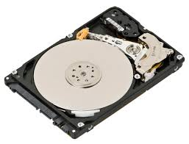
Magnetic Storage
Hard Disk:
Hard drives consist of stacks of non-removable platters coated with magnetic materials each with its own read/write head as shown in the photo.
Hard disk drives are built into desktops and laptops.
It has large storage capacity that is measured in gigabytes.
It holds much more data than a CD-ROM.
They read and write data very quickly.
Hard disk drives use random/direct access to locate data stored on the disk

Slide 7
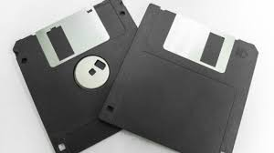
Magnetic Storage
Floppy Disk:
Floppy disks are disks of plastic coated in magnetic material and enclosed in a hard plastic case.
The read/write area is covered by a sliding metal flap.
Floppy disks are written to and read from, through the use of separate floppy disk drives.
Floppy disks are less popular than they have been because :-
They are easily damaged.
Have a limited storage capacity in that they can only hold 1.44MB. Photos, text documents etc have become too large.
Although, they used to be very common they are not much used anymore.

Slide 8
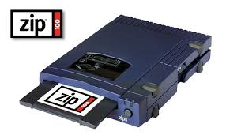
Magnetic Storage
Zip Drive or Super-disks:
Are very similar to floppy disks. Again they are plastic discs coated with magnetic material.
The difference between them is that zip disks can store much more.
The one shown stores 100MB and you can get them up to 250MB.
Like Floppy disks, zip disks need a specialized zip drive to read and write to the disk.

Slide 9
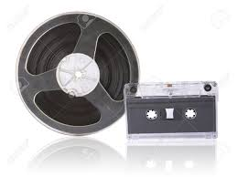
Magnetic Storage
Magnetic Tape:
Made of a long plastic strip coated with magnetic material, tape is mostly used for making backups.
It can store lots of data, but this data is slower to access, this makes it impractical for use as main storage.
One great advantage of magnetic tape is its cheapness.
Magnetic tape uses sequential or serial access to locate data stored on the tape.

Slide 10
Organizing Data on Magnetic Storage
Disk Formatting:
Disk formatting is the process of preparing a data storage device for initial use.
Before a computer can use a magnetic disk to store data the disk surface must be magnetically mapped.
The process of mapping a disk is called formatting.

Slide 11
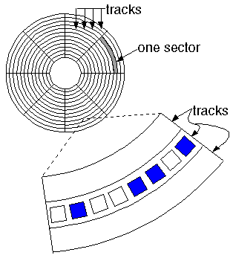
Organizing Data on Magnetic Storage
Tracks and Sectors:
Tracks --- The disk surface is divided into concentric tracks (circles within circles). The thinner the tracks, the more storage.
Sector--- Tracks are further divided into sectors, which hold a block of data that is read or written at one time;
for example, READ SECTOR 782, WRITE SECTOR 5448.
Each sector can store upto 512 bytes.

Slide 12
Disk Management by Operating System
Logical Formatting:
A computer operating system can locate the data on a disk because each track and each sector is labeled and the location of all data is kept in a special log on the disk.
This labeling of tracks and sectors is called logical formatting.
File System:
It is a logical method for managing the storage of data on disk’s surface.
Different operating system use different file systems; FAT, FAT32, NTFS, NTFS5, HPFS

Slide 13
Disk Management by Operating System
When a disk is formatted with FAT file system, four areas are created:
Boot Loader: Contains a program that runs when you first start the computer and determine whether the disk has the basic components necessary to run the operating system.
File Allocation Table (FAT): It is a log that records the location of each file and the status of each sector.
Root Folder: It is a master folder on any disk and act as a tool for organizing files on a disk.
Data Area: The remaining area where the data and program files are actually stored.

Slide 14
Optical Storage
Optical storage is any storage type in which data is written and read with a laser.
Typically, data is written to optical media, such as compact discs (CDs) and DVDs.
Optical discs are not vulnerable to data loss due to power failure like volatile memory.
Optical disc is that the storage medium is inexpensive to manufacture.
The materials are mainly aluminum foil and plastic.
Types:
CD-ROM
DVD-ROM

Slide 15
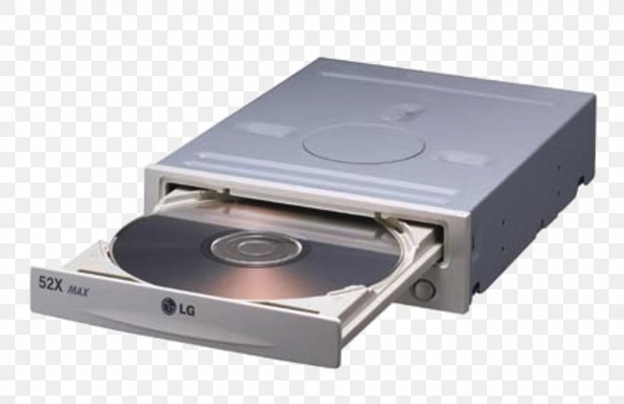
Optical Storage
CD-ROM:
(Compact Disc-Read Only Memory) A type of CD disc that can only be read, but not recorded.
A CD-ROM drive uses a low-power laser beam to read digitized (binary) data that has been encoded in the form of tiny pits on an optical disk.
The drive then feeds the data to a computer for processing.
Used to store programs and data files, a CD-ROM holds 650MB or 700MB of data and employs a different recording format than the audio CD (CD-DA), from which it evolved.
In the 1990s, the CD-ROM rapidly replaced the floppy disk for software distribution.

Slide 16
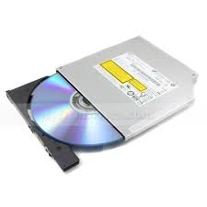
Optical Storage
DVD-ROM:
Digital versatile disc-read only memory (DVD-ROM) is a read-only digital versatile disc (DVD) commonly used for storing large software applications.
It is similar to a compact disk-read only memory (CD-ROM) but has a larger capacity.
DVD-ROM stores around 4.38 GB of data, While a CD-ROM usually stores 650 MB of data.
A DVD-ROM permanently stores data files which cannot be changed, written over or erased.

Slide 17
Solid-State Storage Devices
Solid state devices are not magnetic nor optical.
Instead they relies on integrated circuit to hold data.
Some solid state disk are volatile and some are non-volatile.
The device volatility depends upon the type of memory circuit being used.
The major advantage of solid state disks over standrad storage devices is its speed.
Type:
Flash Memory
Smart Cards
Solid State Disks

Slide 18
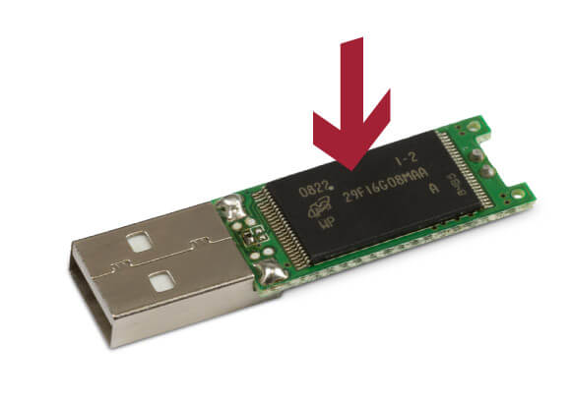
Solid-State Storage Devices
Flash Memory:
Flash memory is a non-volatile memory chip used for storage and for transferring data between a personal computer (PC) and digital devices.
It has the ability to be electronically reprogrammed and erased.
It is a lot less expensive and does not require .
It is non-volatile, has a very fast access time.
Flash memory is extremely durable and can withstand intense pressure or extreme temperatures.
It can be used for a wide array of applications such as digital cameras, mobile phones, laptop computers, PDAs (personal digital assistants), digital audio players

Slide 19
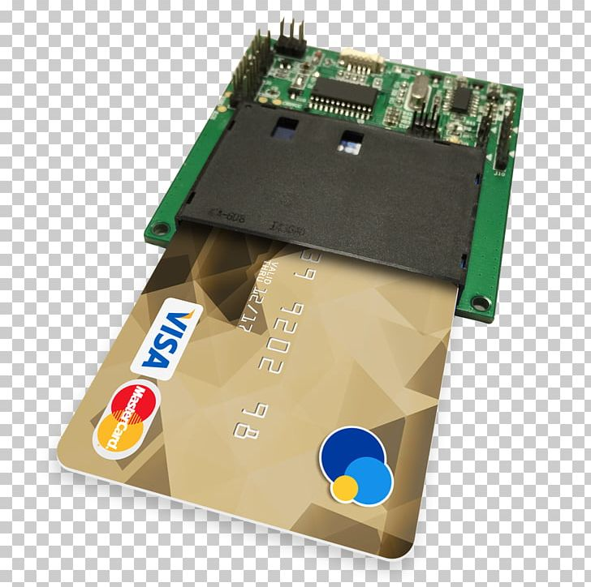
Solid-State Storage Devices
Smart Cards:
A smart card is a physical card that has an embedded integrated chip that acts as a security token.
Those cards with microcontroller chips can perform on-card processing functions and can manipulate information in the chip's memory.
Smart cards are typically the same size as a driver's license or credit card and can be made out of metal or plastic.
They connect to a reader either by direct physical contact (chip and dip) or through a short-range wireless connectivity standard such as radio-frequency identification (RFID) or near-field communication (NFC).
Smart cards are used for a variety of applications, though most commonly are used for credit cards and other payment cards.

Slide 20
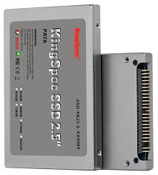
Solid-State Storage Devices
Solid State Disk:
A solid-state drive (SSD) is a new generation of storage device used in computers.
SSDs replace traditional mechanical hard disks by using flash-based memory, which is significantly faster.
Older hard-disk storage technologies run slower, which often makes your computer run slower than it should.
SSDs speed up computers significantly due to their low read-access times and fast throughputs.

Slide 21
THE END

